Slide 1
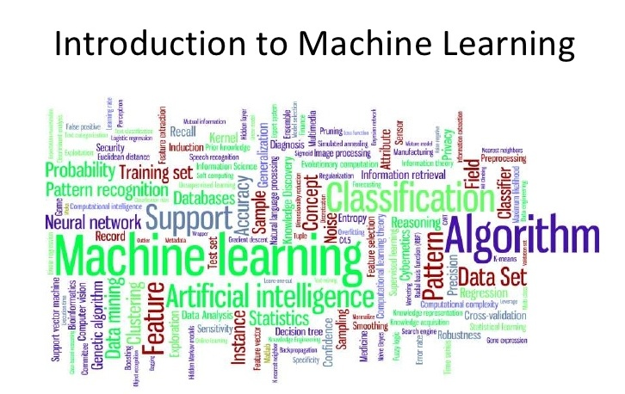
Hosted by : Ankit Grover

Slide 2
What is Machine Learning ?
Field of Study that gives computers the ability to learn without being explicitly programmed.
Ability of a machine to improve its own performance through the use of a software that employs artificial intelligence techniques to mimic the ways by which humans seem to learn, such as repetition and experience.

Slide 3
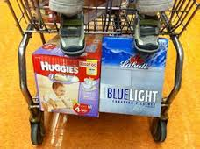
Why Machine Learning ?
Develop systems that can automatically adapt and customize themselves to individual users.
Personalized news or mail filter.
Discover new knowledge from large databases (data mining).
Market based analysis.
For ex : some supermarket placed beer next to diapers and got more business because they mined their sales data and found that men often bought those two items together.

Slide 4
Applications
Amazon customer reviews system.
Facebook’s personalized “News Feed” is being created
IBM Watson could learn how to identify cancer and heart disease from MRI scans and X-Rays.
How does Goolge’s self driving car work?
How do people’s faces on images get detected?
How are spam mails identified?
Google Translate (Optical Character Recognition).

Slide 5
Supervised vs unsupervised learning
Supervised learning:
the output is known
Training data is labelled with their output
It learns a function from the inputs to the outputs which can be used to generate an output for a new instance
Unsupervised learning
The output is unknown
Training data is unlabelled
It aims at discovering information from data

Slide 6
Supervised learning for classification
Marketing:
which promotions are more likely to be effective
which customers are more likely to need a certain product
Identifying positive/negative feedback
Machine vision: Image (face) recognition, handwriting identification, fingerprint identification
Spam/plagiarism detection
Natural language processing: text categorisation (e.g., for indexing), parsing, word sense disambiguation, speech identification

Slide 7
Supervised learning for classification
Step 1: Learning
Given a target concept:
Collect a set of training examples that are representative of the concept
Identify features that are relevant in describing the concept
Learn a model that “explains” the concept (select an algorithm & fine tune it)
Step 2: Classification
Use the model learnt in the previous step to classify an unseen instance

Slide 8
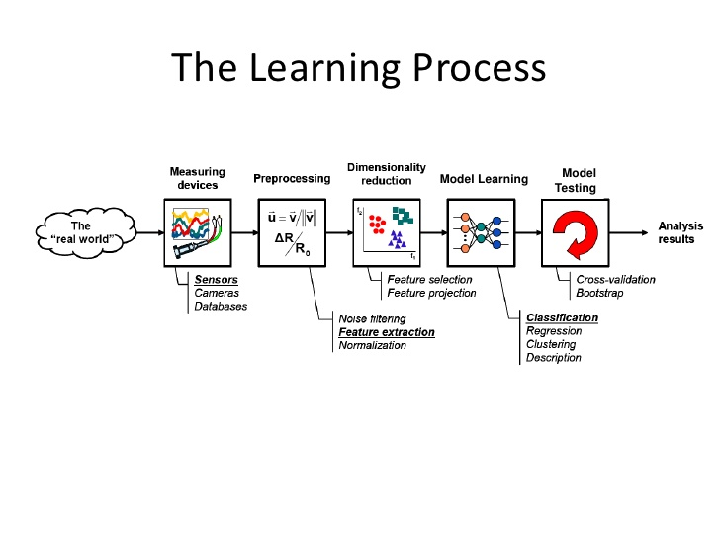

Slide 9
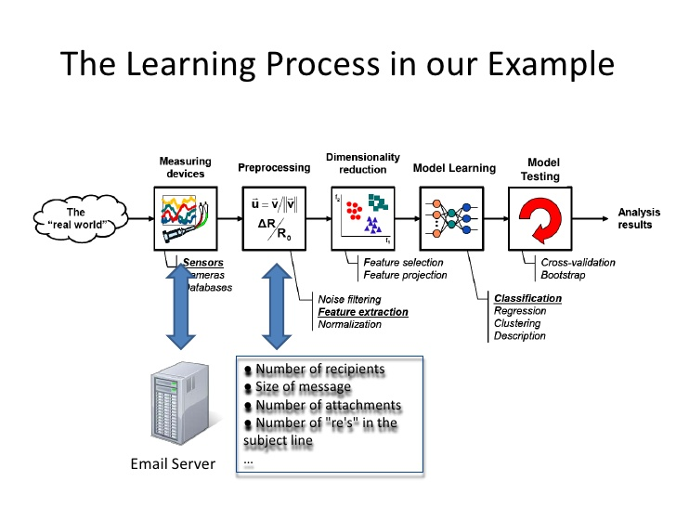

Slide 10
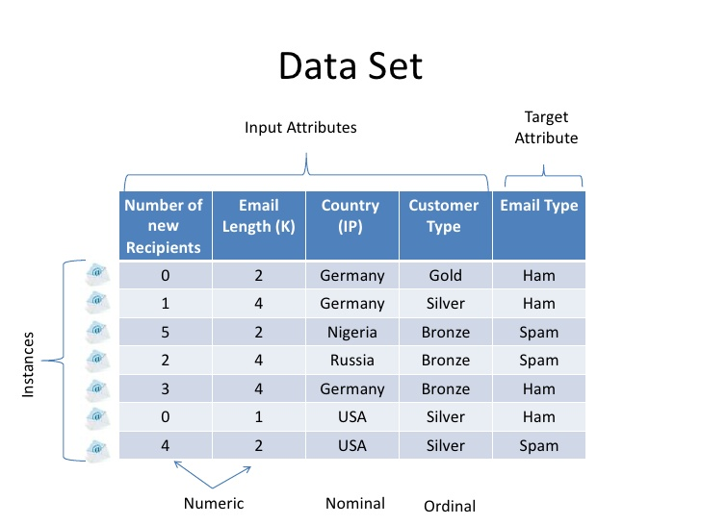

Slide 11
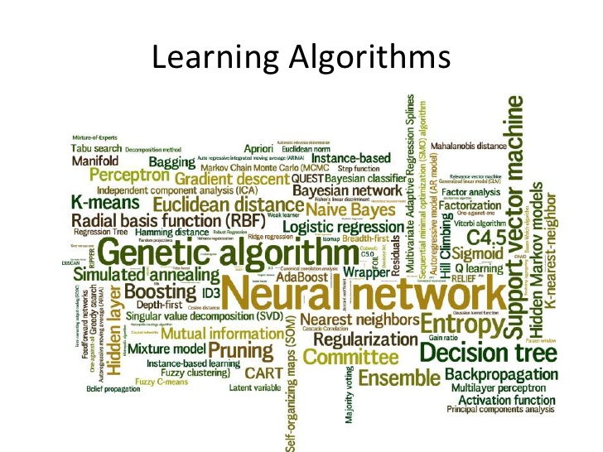

Slide 12
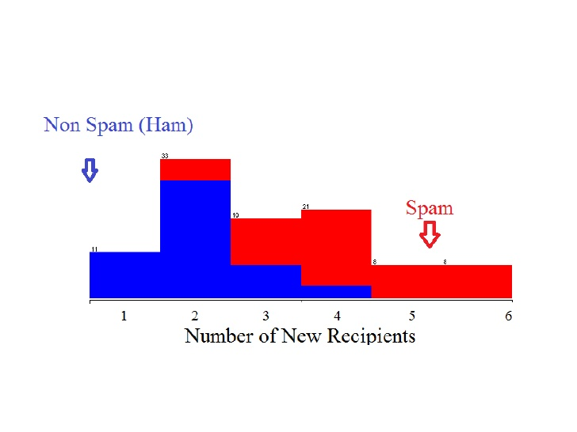

Slide 13
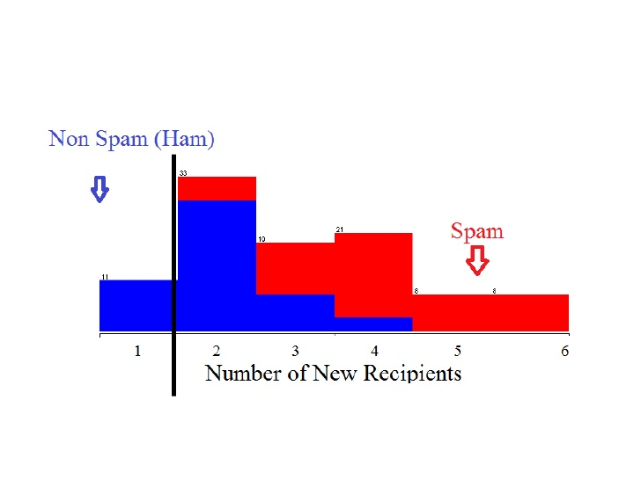

Slide 14
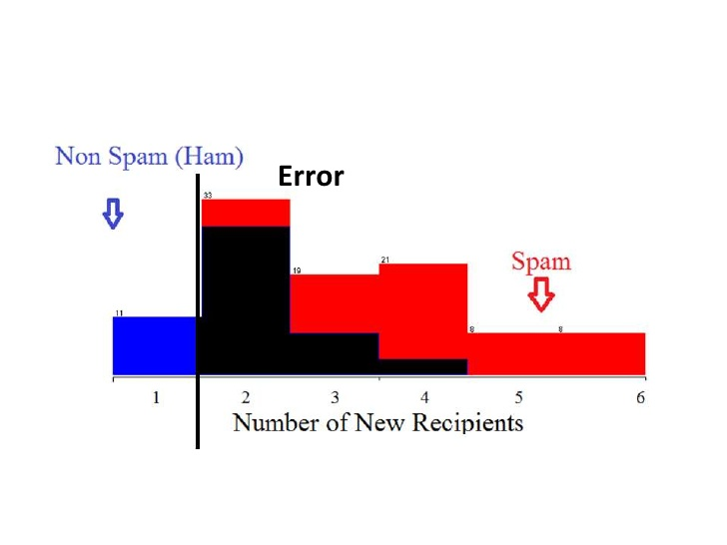

Slide 15
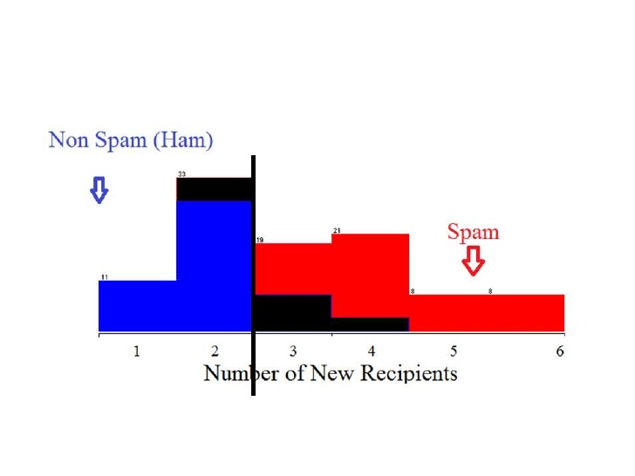

Slide 16
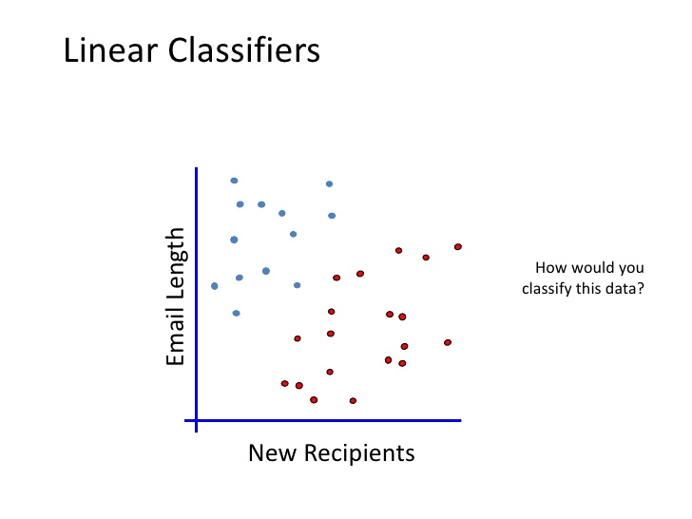

Slide 17
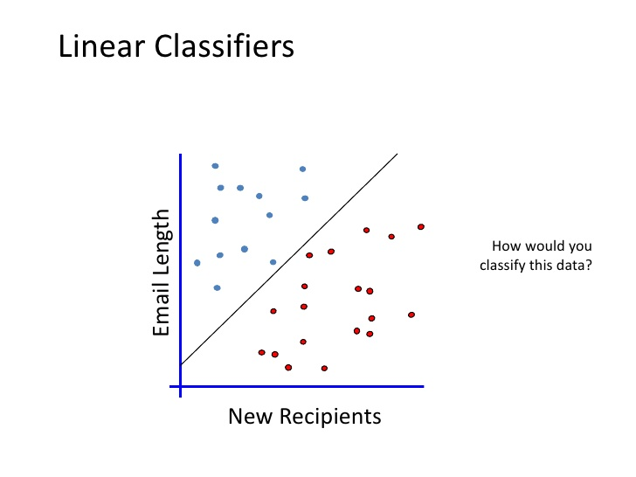

Slide 18
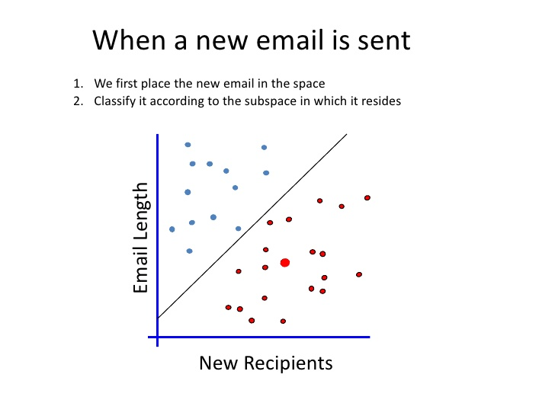

Slide 19
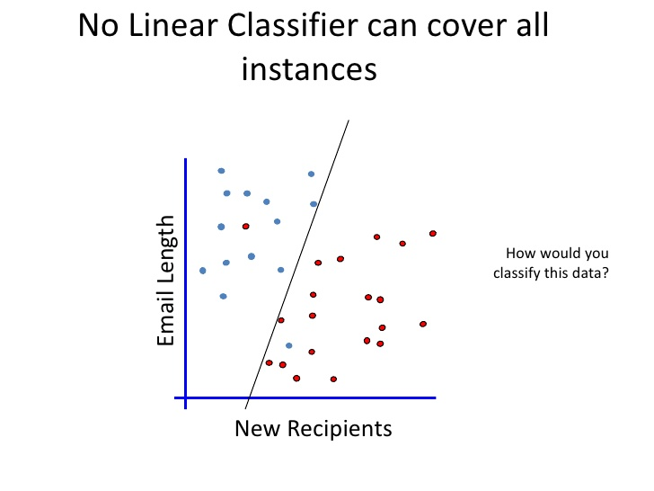

Slide 20
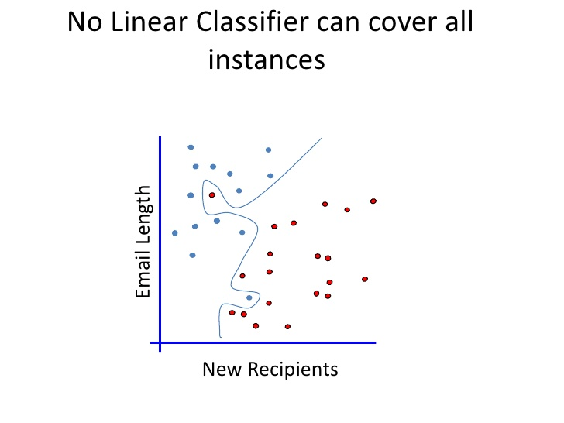
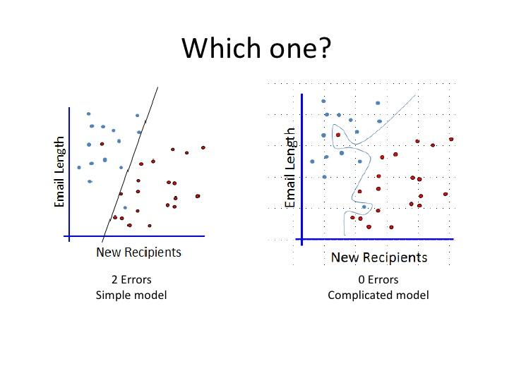

Slide 21
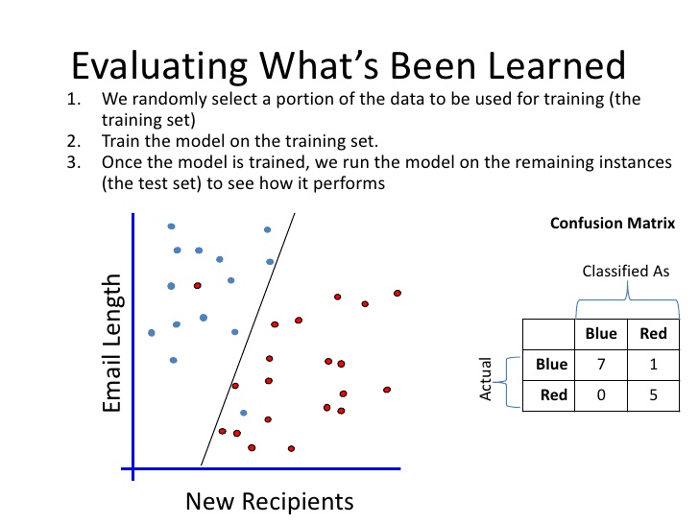

Slide 22
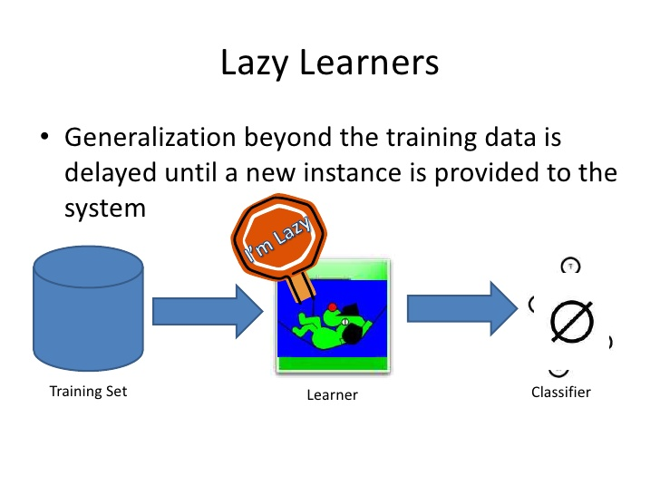

Slide 23
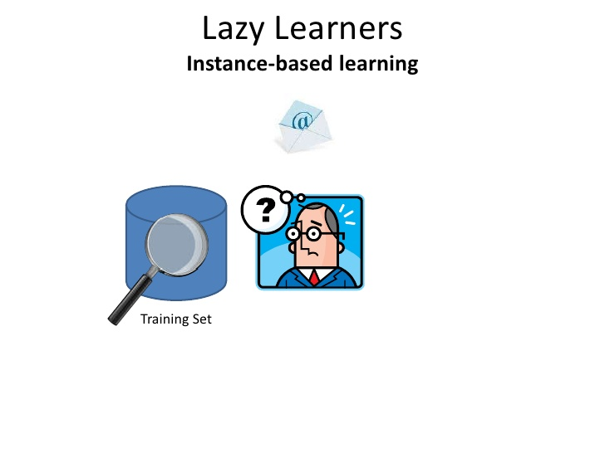

Slide 24
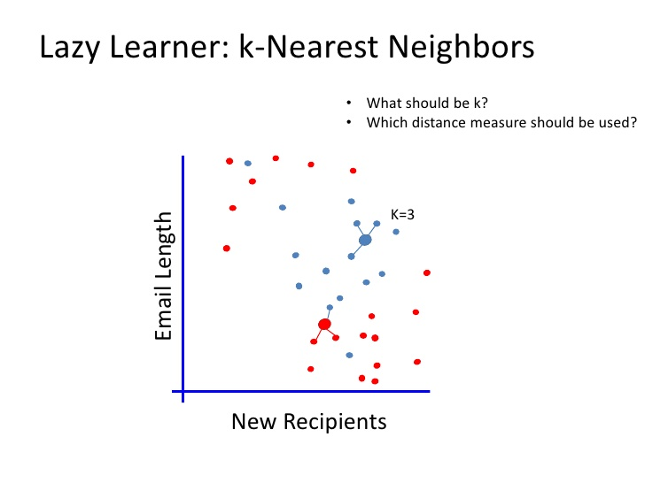

Slide 25
K-nearest neighbour
Compare the classification target with the set of training examples using a distance function Chose as output the class that the majority of the k closest neighbours belong to
Spam
Ham
K=1
K=3
K=5

Slide 26
Unsupervised learning
Deals with identifying patterns
It works with observed patterns (assumed to be independent samples from some probability distribution)
Has some explicit or implicit knowledge of what is important
Has no knowledge or expectations of target outputs

Slide 27
What is Clustering?
Organizing data into classes such that there is
high intra-class similarity
low inter-class similarity
Finding the class labels and the number of classes directly from the data (in contrast to classification).
More informally, finding natural groupings among objects.

Slide 28
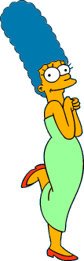



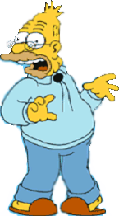
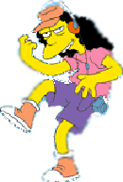


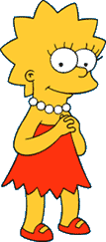
What is a natural grouping among these objects?

Slide 29


What is a natural grouping among these objects?
Clustering is subjective
Simpson's Family
School Employees
Females
Males

Slide 30
Algorithm k-means
1. Randomly choose K data items from X as initial centroids.
2. Repeat
Assign each data point to the cluster which has the closest centroid.
Calculate new cluster centroids.
Until the convergence criteria is met.

Slide 31
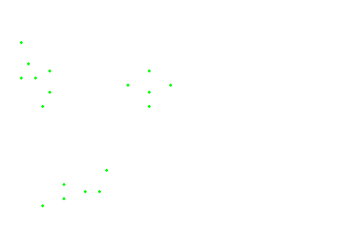
The data points

Slide 32
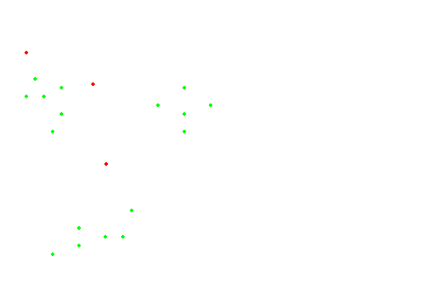
#Runs = 1

Slide 33
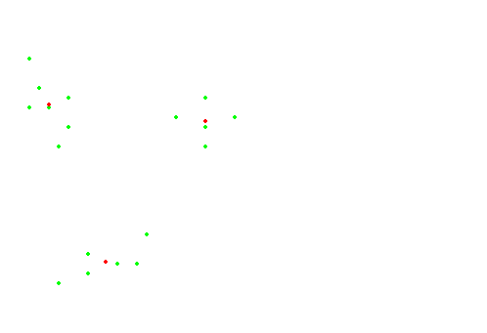
#Runs = 2

Slide 34
Applications of K-means Method
Optical Character Recognition
Biometrics
Diagnostic Systems
Military Applications

Slide 35
Neural Networks
Origins : Algorithms that try to mimic the brain.
Was very widely used in 80s and early 90s; popularity diminished in late 90s.
Computationally more expensive algorithms.
Recent Resurgence: State-of-the art technique for many applications.
An artificial neural network (ANN), usually called "neural network" (NN), is a mathematical model or computational model that tries to simulate the structure and/or functional aspects of biological neural networks.

Slide 36
Why use neural networks
Neural networks, with their remarkable ability to derive meaning from complicated or imprecise data, can be used to extract patterns and detect trends that are too complex to be noticed by either humans or other computer techniques.
A trained neural network can be thought of as an "expert" in the category of information it has been given to analyze.
Adaptive learning: An ability to learn how to do tasks based on the data given for training or initial experience.

Slide 37
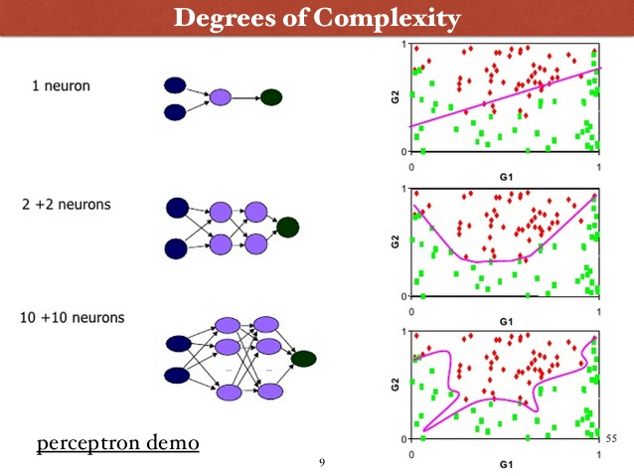

Slide 38
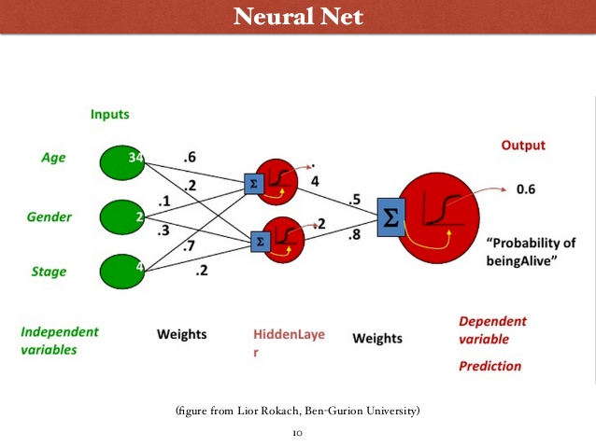

Slide 39
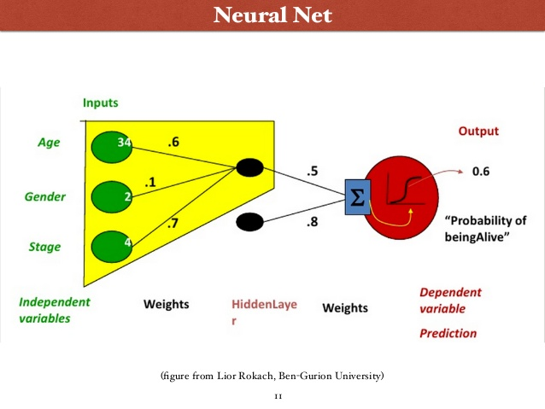

Slide 40
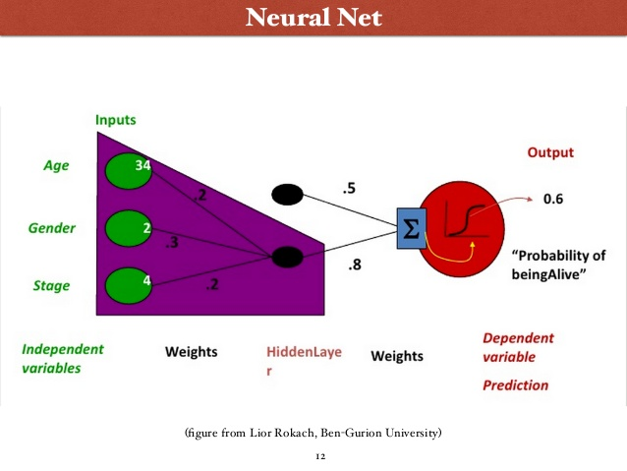

Slide 41
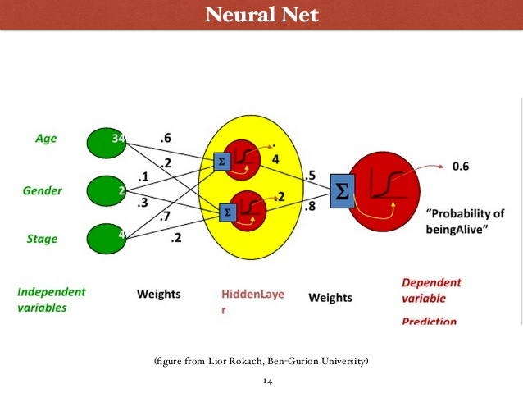

Slide 42
Any Questions ?

